Slide 1


VISVESVARAYA TECHNOLOGICAL UNIVERSITY BELGAUM – 590018, KARNATAKA, INDIA
EAST WEST INSTITUTE OF TECHNOLOGY
DEPARTMENT OF COMPUTER SCIENCE AND ENGINEERING
Presentation on mini project
“HOTEL ROOM BOOKING WEBSITE”
UNDER THE GUIDANCE OF :
Prof. KIRAN M
Asst. Prof. Dept of CSE,
EWIT
SUBMITTED BY: BY :
SANDESH POKHREL (1EW17CS128)
SOUNDARYA K (1EW17CS130)

Slide 2
CONTENTS
ABSTRACT
INTODUCTION TO WEB DEVELOPMENT
PROJECT DESCRIPTION
SNAPSHOTS
REQUIREMENTS
CONCLUSION
REFERENCES

Slide 3
ABSTRACT
This Online Hotel Reservation System is an automated system that allows your guest to plan their bookings online at their convenience. With the help of this system, you can manage well your business that can increase both your efficiency within the office and your profit. Now, your bookings are easily accessible anytime and anywhere as long as you have an internet connection and a laptop, Smartphone or tablet because it has a very responsive design. Compared to a manual process that may take you a lot of time to book, this process of online booking a room made simple, easy and enjoyable because it provides a friendly user interface.

Slide 4
INRODUCTION TO WEB DEVELOPMENT
Web consists of billions of clients and server connected through wires and wireless networks. The web clients make requests to web server.
The web server receives the request, finds the resources and returns the response to the client. When a server answers a request, it usually sends some type of content to the client. The client uses web browser to send request to the server.
The server often sends response to the browser with a set of instructions written in Hyper Text Mark-up Language (HTML). All browsers know how to display HTML page to the client.

Slide 5
PROJECT DESCRIPTION
The following are the different kinds of features available in our website. They are classified into two groups as listed below:
Admin side
Manage Rooms
Manage Accommodation
Manage Reservation
Generate Reports
Manage Users
So basically in admin side we can add or remove rooms , manage the types of the accommodations provided, accept or discard the reservations, Generate the reports and manage the users.

Slide 6
PROJECT DESCRIPTION
Public Side
Home
Room and Rates
About Us
Contact Us
Guest Profile
Manage Booking Cart
Reservation Details
Submit Reservation
Login and Logout
This is basically the user side where user will see a very responsive home page where they will be doing all their procedures. They can see rooms and the services along with the rates. They can read about the website in about us section. They will have a personal cart where their selected rooms will go temporarily. Before any transaction user need to login or register and also after finishing booking they will have the option to logout.

Slide 7
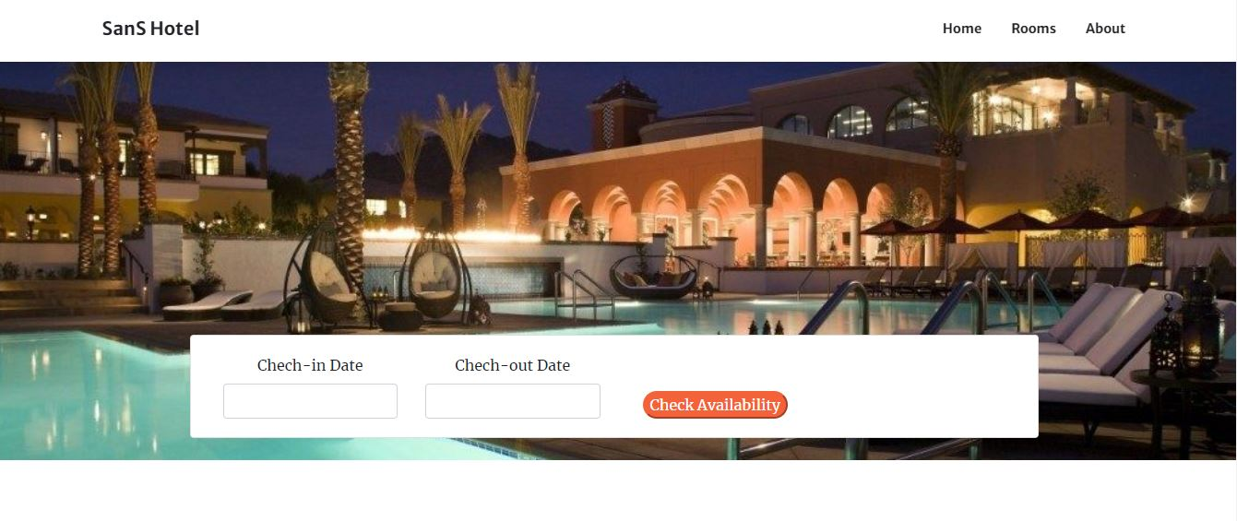
SNAPSHOTS HOME PAGE

Slide 8
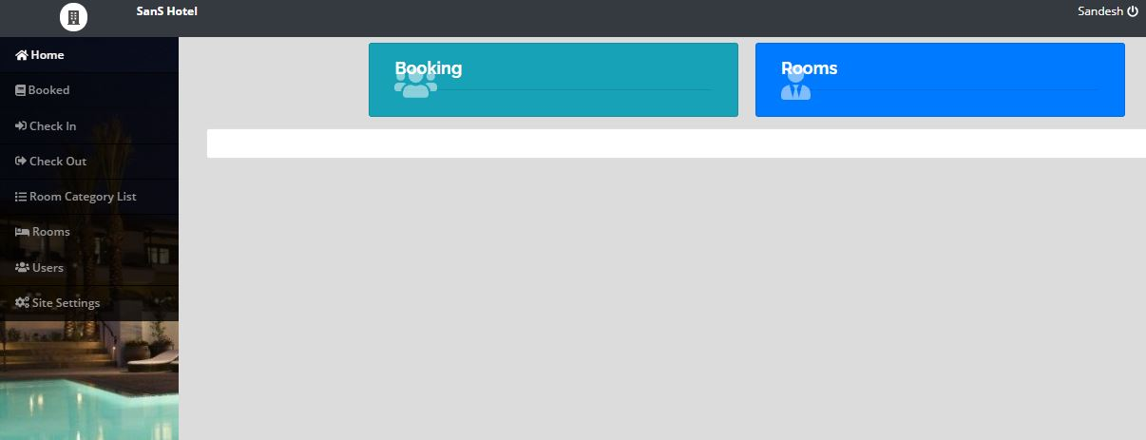
SNAPSHOTS ADMIN PAGE

Slide 9
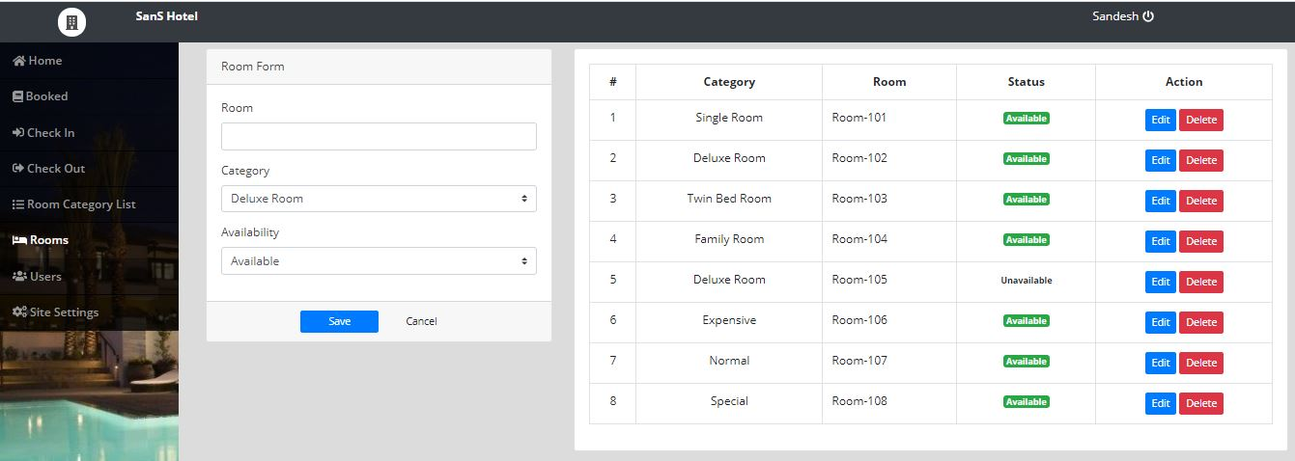
SNAPSHOTS ROOMS PAGE

Slide 10
REQUIREMENTS
Operating system : Windows 10
Server : Xampp/Wampp Server
Frontend : HTML, CSS
Backend : PHP, MySQL, JS

Slide 11
CONCLUSION
The project entitled “Hotel Room booking website” is developed using HTML, CSS and JavaScript as front end and Mysql database in back end to computerize the process of online management of customers and bookings of the hotel rooms.
This project covers only the basic features required. This web application involves almost all the features of the online booking. The future implementation will be online help for the customers and chatting with website administrator.
The project greatly helped in understanding the various phases in website development and exposure to a new developer platform using PHP, HTML and database MySQL.

Slide 12
REFERENCES
Robin Nixon, “Learning PHP, MySQL &JavaScript with jQuery, CSS and HTML5”, 4thEdition, O’Reilly Publications, 2015. (ISBN:978-9352130153)
Luke Welling, Laura Thomson, “PHP and MySQL Web Development”, 5th Edition, Pearson Education, 2016. (ISBN:978-9332582736)
Nicholas C Zakas, “Professional JavaScript for Web Developers”, 3rd Edition, Wrox/Wiley India, 2012. (ISBN:978-8126535088)
David Sawyer Mcfarland, “JavaScript & jQuery: The Missing Manual”, 1st Edition, O’Reilly/Shroff Publishers & Distributors Pvt Ltd, 2014 (ISBN:9789351108078)
Zak Ruvalcaba Anne Boehm, “Murach's HTML5 and CSS3”, 3rdEdition, Murachs/Shroff Publishers & Distributors Pvt Ltd, 2016. (ISBN:978-9352133246)

